Slide 1

CAPSTONE PROJECT
Fake News Detection
Final Project
Presented By
GOKUL P
711721244019
III BTech CSBS KGISL Institute of Technology
3/21/2024 Annual Review
1

Slide 2

PROJECT TITLE
Fake News Detection Using Convolutional Neural Networks (CNN) is a project that aims to address the pervasive issue of misinformation and deception in online content by leveraging advanced machine learning techniques.
3/21/2024 Annual Review
2

Slide 3



AGENDA
Introduction
Problem Statement
Project Overview
End Users
Solution Highlights
Modeling Approach
Results
Conclusion
3/21/2024 Annual Review
3

Slide 4

PROBLEM STATEMENT
Highlight the prevalence and harmful effects of fake news in today's digital landscape.
Current methods of manual fact-checking are slow and insufficient to combat the sheer volume of misinformation.
There is a critical need for automated solutions to swiftly identify and mitigate the spread of fake news online.
3/21/2024 Annual Review
4

Slide 5

PROJECT OVERVIEW
Our project aims to combat the proliferation of misinformation by employing Convolutional Neural Networks (CNNs), an advanced machine learning technique.
By leveraging CNNs, we intend to develop a robust system capable of analyzing textual and visual content to discern patterns indicative of fake news.
The ultimate goal is to create an automated, scalable solution that can detect fake news in real-time, thus mitigating its harmful impact.
3/21/2024 Annual Review
5

Slide 6

WHO ARE THE END USERS?
Our solution caters to a diverse range of end users, including:
Social media platforms: Integrating fake news detection algorithms to bolster content moderation efforts.
News organizations: Automating fact-checking processes to ensure the accuracy and integrity of news reporting.
General public: Empowering individuals to discern and avoid consuming fake news and misinformation.
3/21/2024 Annual Review
6

Slide 7

YOUR SOLUTION AND ITS VALUE PROPOSITION
Our solution offers several key value propositions:
Automated detection: Saves time and resources by automating the identification of fake news.
Real-time detection: Enables swift intervention to prevent the spread of misinformation as it emerges.
Scalability: Capable of analyzing vast amounts of online content, making it suitable for deployment on large-scale platforms.
Trust and credibility: By curbing the spread of fake news, our solution fosters trust in online information sources.
3/21/2024 Annual Review
7

Slide 8

THE WOW IN YOUR SOLUTION
Our solution distinguishes itself by harnessing the power of CNNs to analyze both textual and visual content simultaneously.
The integration of advanced machine learning techniques enables our system to adapt and improve over time, enhancing its accuracy and effectiveness.
Real-time detection capabilities add a crucial dimension to our solution, enabling proactive measures to combat misinformation as it emerges.
3/21/2024 Annual Review
8

Slide 9
MODELLING
Our modeling approach involves training CNNs on labeled datasets of textual and visual content.
Textual data undergoes preprocessing and is fed into the CNN, while visual data is analyzed using pre-trained CNN architectures.
By combining insights from both modalities, our unified framework enhances the accuracy and reliability of fake news detection.
3/21/2024 Annual Review
9

Slide 10
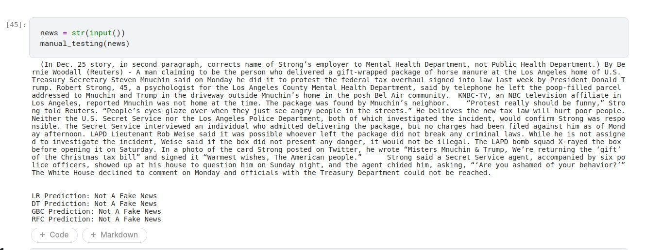
RESULTS
10

Slide 11
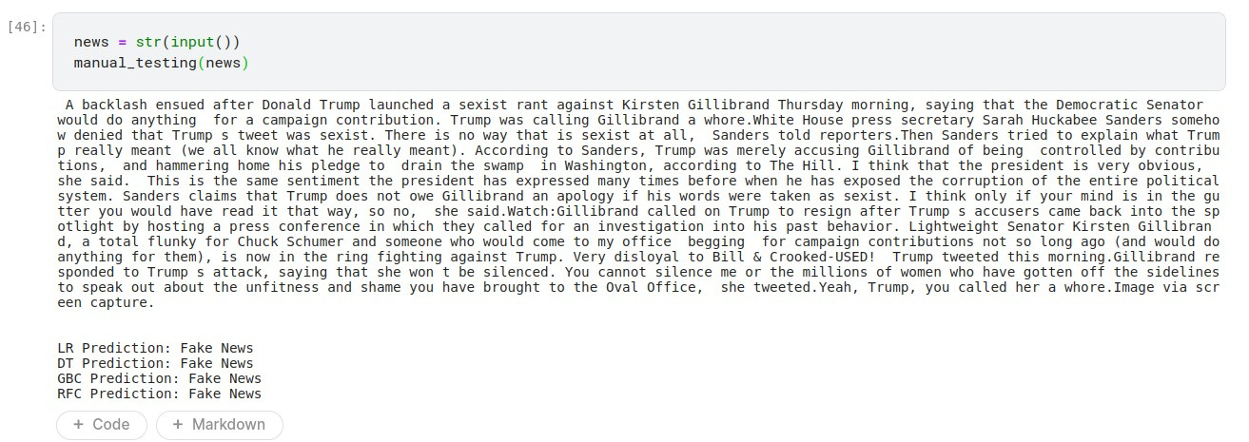
RESULTS
Demo Link
3/21/2024 Annual Review
10

